Slide 1
Dr. SNS RAJALAKSHMI COLLEGE OF ARTS & SCIENCE (Autonomous)
Coimbatore -641049
Accredited by NAAC(Cycle–III) with ‘A+’ Grade
(Recognized by UGC, Approved by AICTE, New Delhi and
Affiliated to Bharathiar University, Coimbatore)
DEPARTMENT OF COMPUTER SCIENCE (GRAPHICS AND CREATIVE DESIGN)
COURSE NAME : INTRODUCTION TO COMPUTER ANIMATION
II YEAR /III SEMESTER
Unit I- Methods of Recording

Slide 2
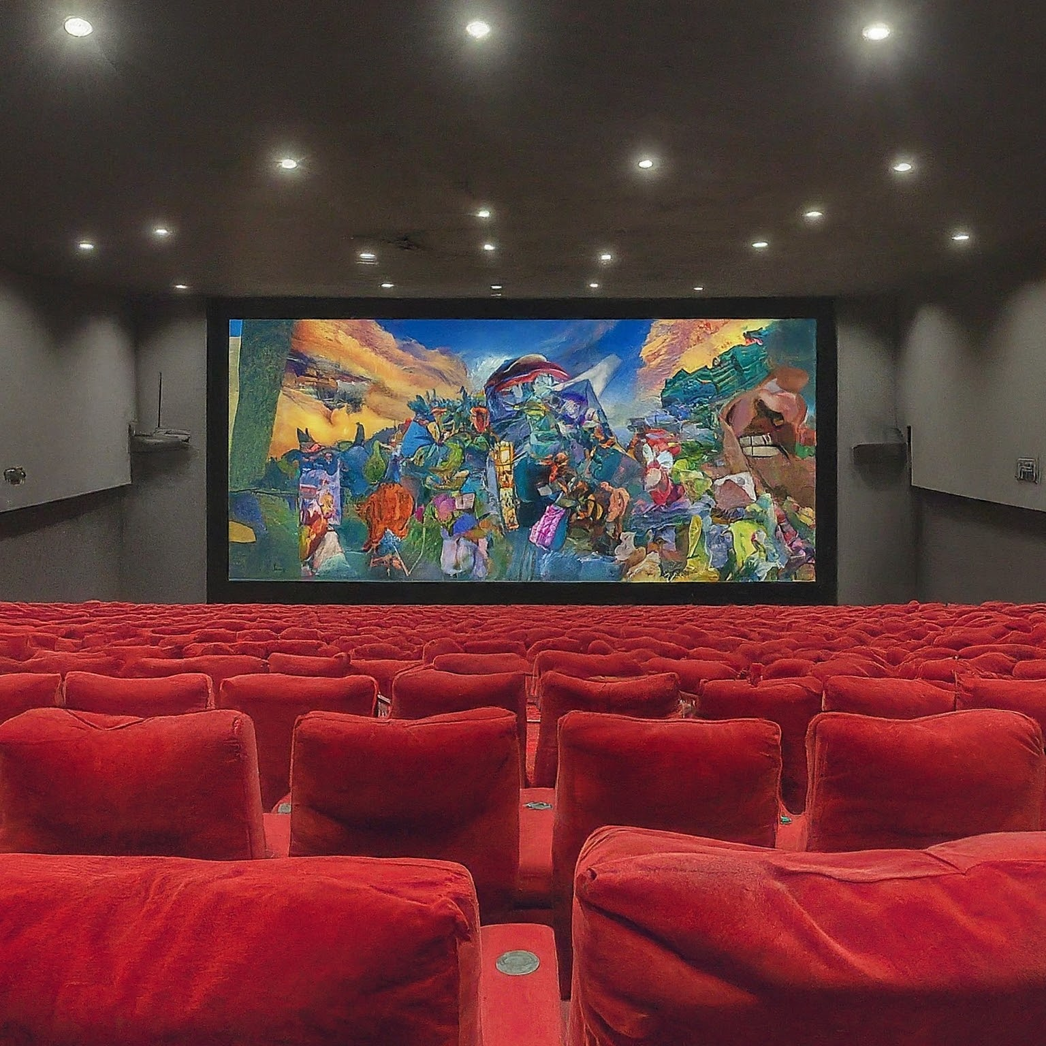
Methods of Recording
Recording in computer animation involves capturing the movement, actions, and changes of digital objects or characters to create a sequence of frames that simulate motion.
Keyframe Animation:
Manual Keyframing: Animators set keyframes at specific points in time, defining the position, rotation, scale, and other attributes of objects or characters. The software interpolates the frames between keyframes to create smooth motion.
Auto-Keying: Some animation software automatically sets keyframes as animators make changes to the object or character attributes. This speeds up the animation process but may require adjustments to achieve desired results.
Notes:
Welcome to this presentation on the methods of recording in computer animation! In the world of animation, bringing characters and stories to life goes beyond just creating stunning visuals. Recording plays a crucial role in capturing movement, sound, and other elements that breathe life into the animation. This presentation will explore the various techniques used to record different aspects of computer animation.

Slide 3
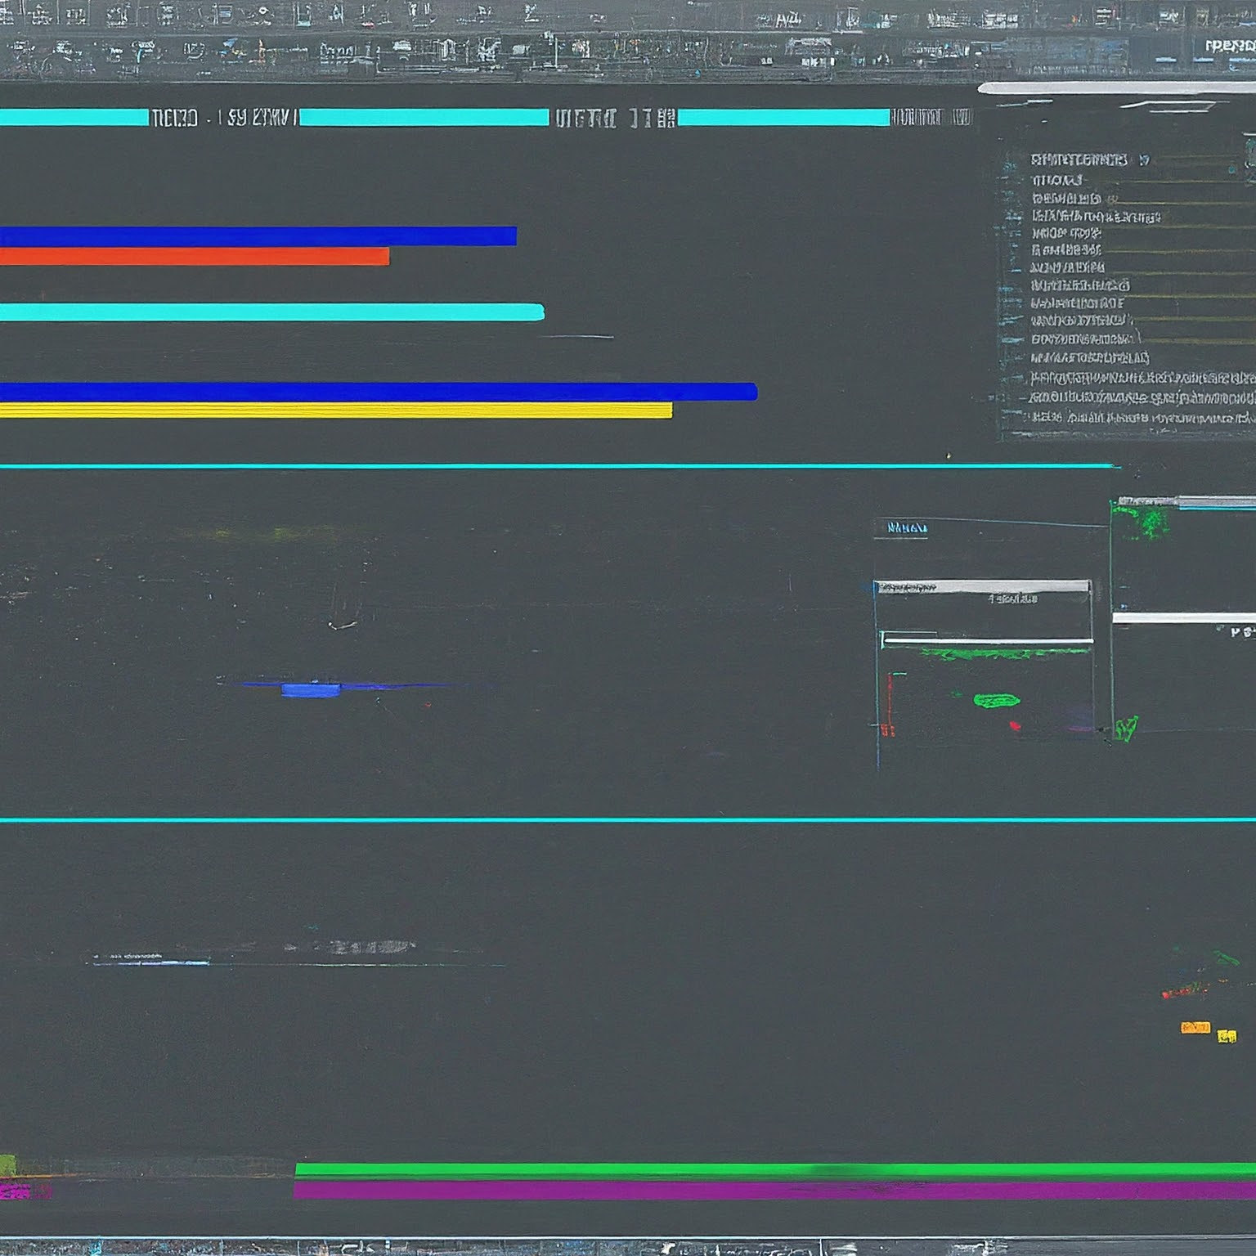
Keyframe Animation
Keyframe animation is a fundamental recording method.
Animators set key poses for a character or object at specific points in time.
Software interpolates (fills in) the in-between frames, creating smooth animation.
Notes:
Keyframe animation is a cornerstone technique used in various animation software. Animators set key poses, which are defining moments in an animation sequence, for a character or object at specific points in the timeline. The software then calculates and fills in the in-between frames, creating a smooth flow of movement between the keyframes. This method allows for precise control over the animation's timing and pacing.

Slide 4
Motion Capture
Motion capture (mocap) records real-world movements.
Actors wear suits with reflective markers, and their movements are tracked by cameras.
Captured data is applied to a digital character, replicating the movement.
Notes:
Motion capture technology revolutionized the animation industry by enabling the recording of real human movement. Actors wear special suits embedded with reflective markers, and their movements are tracked by a network of high-speed cameras within a studio environment. The captured data is then applied to a digital character's skeleton, allowing the animation to realistically mimic the recorded performance. This method is particularly useful for animating complex actions and emotions.

Slide 5
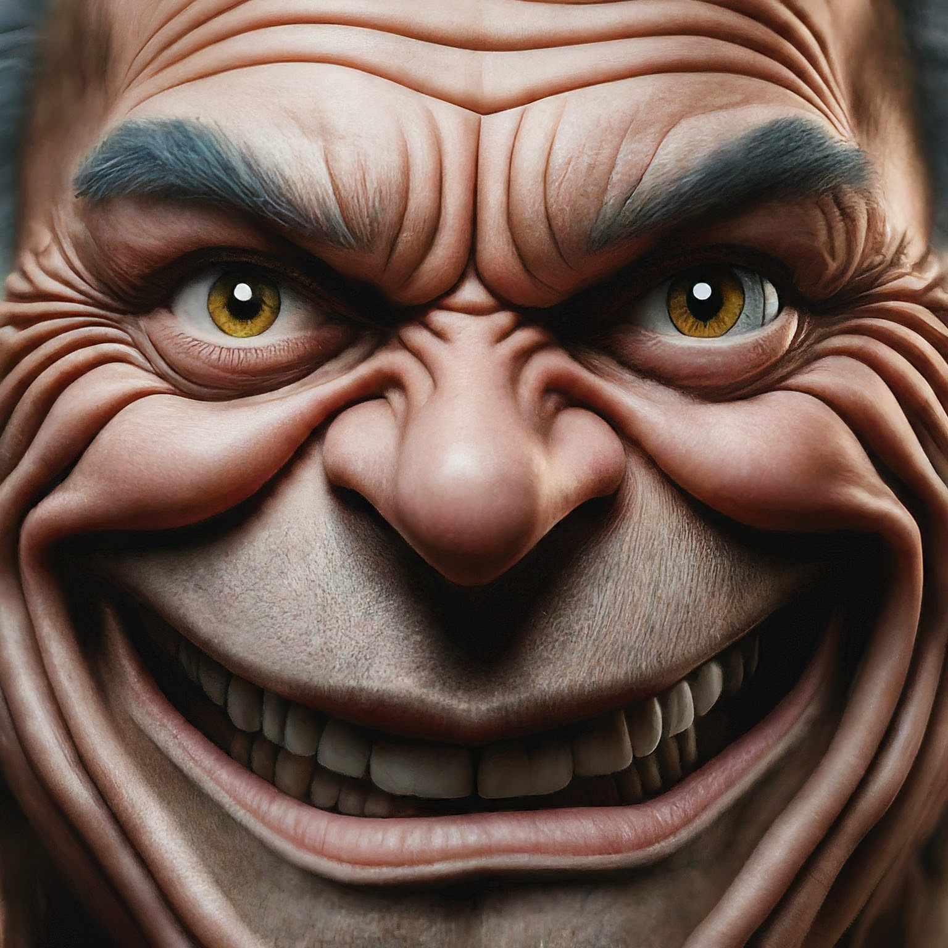
Facial Animation
Facial animation captures subtle expressions for realistic emotions.
Specialized software and techniques are used to animate facial features.
Techniques include blend shapes, morph targets, and muscle simulation.
Notes:
Facial animation goes beyond just moving a character's mouth in sync with dialogue. It's about capturing the subtle nuances of human expressions that convey emotions and connect with viewers. Specialized animation software and techniques like blend shapes (predefined facial expressions), morph targets (transitioning between shapes), and muscle simulation are employed to create lifelike facial movements. These methods enable animators to express a wide range of emotions through the character's face, enhancing the storytelling aspect of the animation.

Slide 6
Lip Syncing
Lip syncing ensures the character's mouth movements match the spoken dialogue.
Animators use audio waveforms or phonetic tools to create mouth movements.
Advanced techniques can capture subtleties like breathing and tongue movement.
Notes:
Lip syncing is crucial for creating a believable and engaging experience in animated films and media. Animators employ various techniques to ensure the character's mouth movements are synchronized with the spoken dialogue. This can involve using audio waveforms or phonetic tools that analyze the sounds and translate them into corresponding mouth actions. Advanced lip-syncing technologies can even capture subtle details like breathing and tongue movement, further enhancing the realism of the character's speech.

Slide 7
Voice Acting and Sound Design
Voice acting breathes life into characters through voice performances.
Voice actors deliver dialogue, narration, and sound effects.
Sound design creates the overall soundscape of the animation.
Foley artists create realistic sound effects for actions and movements.
Notes:
Voice acting plays a vital role in storytelling and character development in animation. Voice actors bring characters to life by delivering engaging and believable dialogue, narration, and even sound effects. They breathe personality into the characters, allowing viewers to connect with them on an emotional level. Additionally, sound design encompasses the creation of the entire sounds

Slide 8
Foley Art
Foley art creates realistic sound effects for actions and movements.
Foley artists use everyday objects and props to recreate specific sounds.
Examples: Crinkling cellophane for footsteps on snow, celery stalks for breaking bones.
Notes:
Foley art is a fascinating technique within sound design that adds a layer of realism and immersion to the animation. Foley artists are like sound magicians who use everyday objects and props to recreate specific sound effects for actions and movements within the animation. From crinkling cellophane to mimic footsteps on snow, to using celery stalks to create the sound of breaking bones, the possibilities are endless. Foley artists rely on their creativity, resourcefulness, and understanding of sound to bring the animation to life through these meticulously crafted sound effects.

Slide 9
ADR (Automated Dialogue Replacement)
ADR (Automated Dialogue Replacement) refines or replaces dialogue after animation.
Actors may re-record dialogue in a controlled studio environment.
ADR allows for cleaner audio, improved timing, and emotional adjustments.
Notes:
While voice acting plays a crucial role during animation production, ADR (Automated Dialogue Replacement) provides an additional layer of refinement. It's a process where actors re-record their dialogue in a controlled studio environment, separate from the animation production stage. ADR offers several advantages. It allows for cleaner audio recordings free from background noise or imperfections present during initial recording sessions. Additionally, ADR enables actors to fine-tune their performances,

Slide 10
Foley Art
Creates realistic sound effects for actions and movements.
Uses everyday objects and props to recreate specific sounds.
Examples: Crinkling cellophane for footsteps on snow, celery stalks for breaking bones.
Notes:
Foley art is a fascinating technique within sound design that adds a layer of realism and immersion to the animation. Foley artists are like sound magicians who use everyday objects and props to recreate specific sound effects for actions and movements within the animation. From crinkling cellophane to mimic footsteps on snow, to using celery stalks to create the sound of breaking bones, the possibilities are endless. Foley artists rely on their creativity, resourcefulness, and understanding of sound to bring the animation to life through these meticulously crafted sound effects. Imagine a scene where a character walks through a snowy forest. A foley artist might use crinkling cellophane to create the sound of footsteps crunching in the snow. Or, for a scene with a fight sequence, they might use celery stalks or carrots to create the sickening snap of breaking bones. Foley art adds a layer of detail and realism that can make all the difference in the final product.

Slide 11
Conclusion
Recording in computer animation is multifaceted.
Combines various methods to capture movement, sound, and emotions.
Effective recording techniques breathe life into animation.
Notes:
In conclusion, recording in computer animation goes far beyond simply capturing visuals. It's a multifaceted process that combines various methods to capture movement, sound, and the subtle nuances of human emotion. From keyframe animation and motion capture to voice acting, sound design, and music composition, each recording technique plays a crucial role in bringing a story and its characters to life. By effectively utilizing these recording methods, animators can create captivating stories that resonate with audiences and leave a lasting impression. Effective recording techniques are the foundation of creating believable and engaging characters, setting the emotional tone for each scene, and ultimately, weaving a story that connects with viewers on a deeper level. The next time you watch an animated film, take a moment to appreciate the incredible work that goes into the recording process. It's a true collaboration between animators, actors, sound designers, and composers, all working together to create a magical and immersive experience.

Slide 12
Thank You

